Slide 1
A Graphical User Interface for Object Detection and Tracking With Introducing a Rail Detector as Case Study
Presenter: Mohammad Ashraful Alam
Supervisor: Prof. Dr. Ing Axel Gräser
Tutor : M. Sc. Damon Emami

Slide 2
Contents
Objective
Features Used in GUI
Graphical User Interface
Examples
Case Study
Performance of Rail Detector

Slide 3
Objective
Develop a User Interface for Object Detection and Tracking
Include Cascade Classifier detector
Allow User to Add or Remove Detectors
Include all of the feature detection techniques provided by OpenCV and C++
Include Set Feature Parameter Interface
Include crop object functionality in the case if the Detector does not detect object
Remove all kinds of bugs to make the interface more user friendly.

Slide 4
For Object Detection
Cascade Classifier with
1) Haar Like feature
2) Local Binary Point (LBP) feature
3) Histogram of Oriented Gradient (HOG) feature

Slide 5
For Object Tracking and Feature Maching
Scale Invarient Feature Transform (SIFT)
Speeded Up Robust Feature (SURF)
Features from Accelerated Segment Test (FAST)
Binary Robust Independent Elementary Features (BRIEF)
Oriented FAST and Rotated BRIEF (ORB)

Slide 6
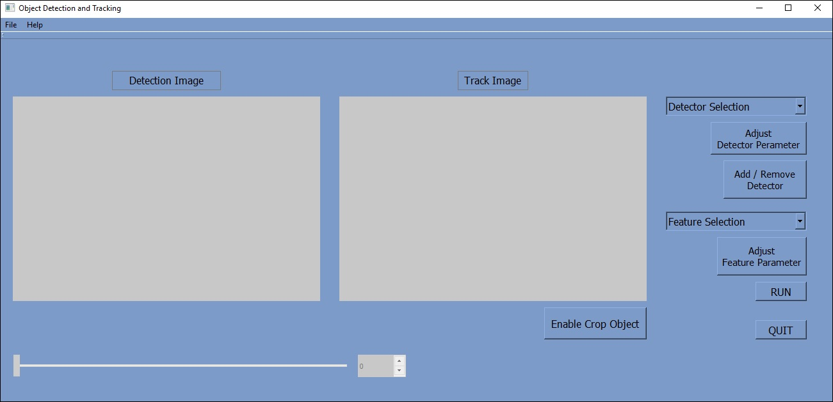
Main Interface...

Slide 7
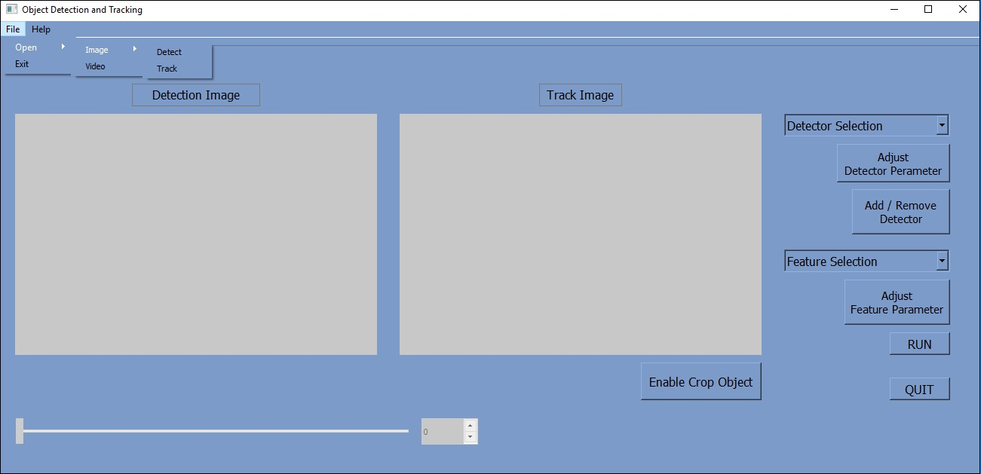
Main Interface...

Slide 8
Main Interface...

Slide 9
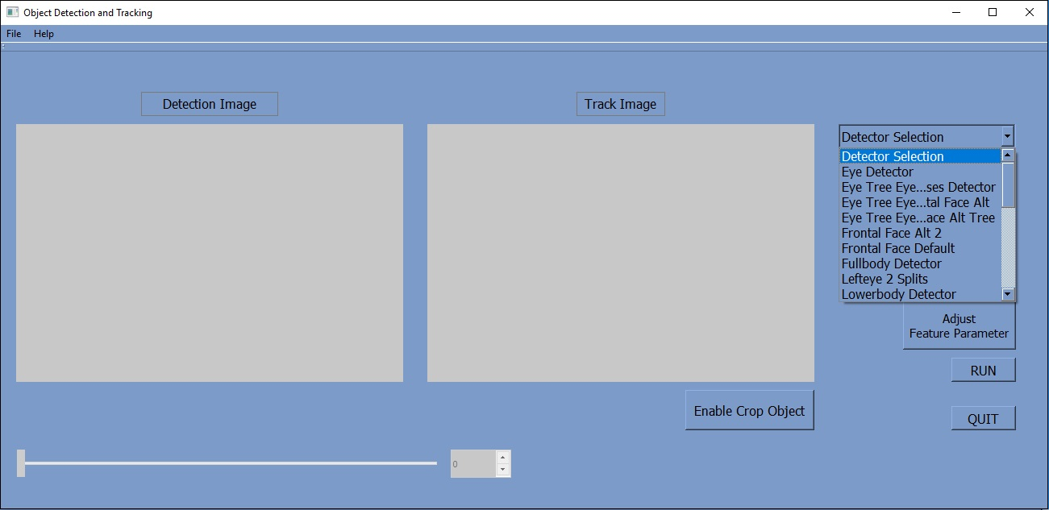
Main Interface...

Slide 10
Main Interface...

Slide 11
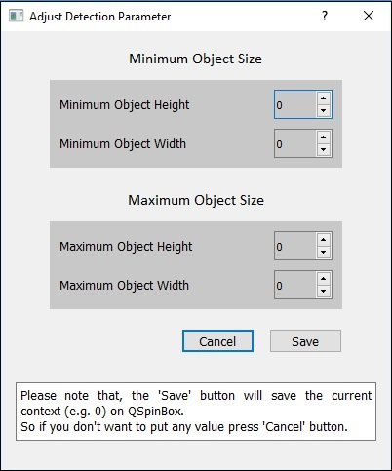
Main Interface...

Slide 12
Main Interface...

Slide 13
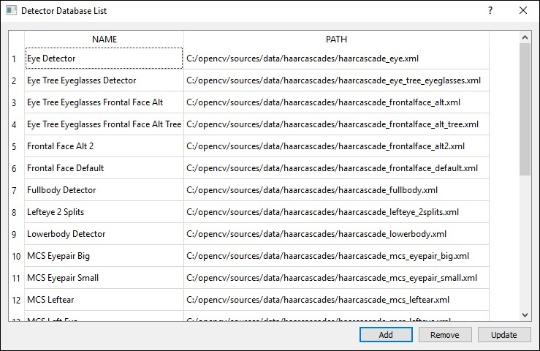
Main Interface...

Slide 14
Main Interface...

Slide 15
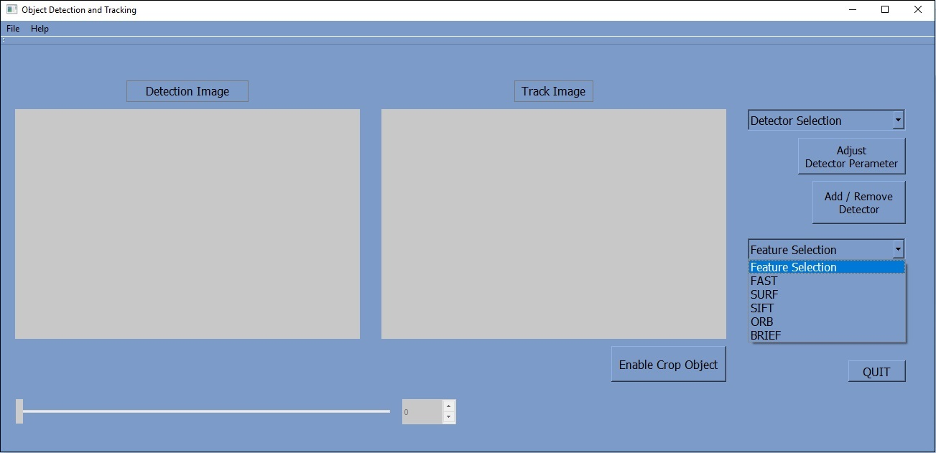
Main Interface...

Slide 16
Main Interface...

Slide 17
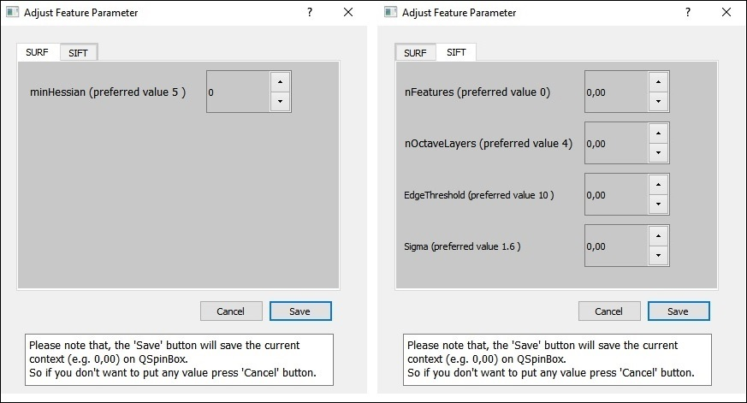
Main Interface...

Slide 18
Main Interface...

Slide 19
Examples
To use this Interface, we only need
1) two pictures
or
2) a video

Slide 20
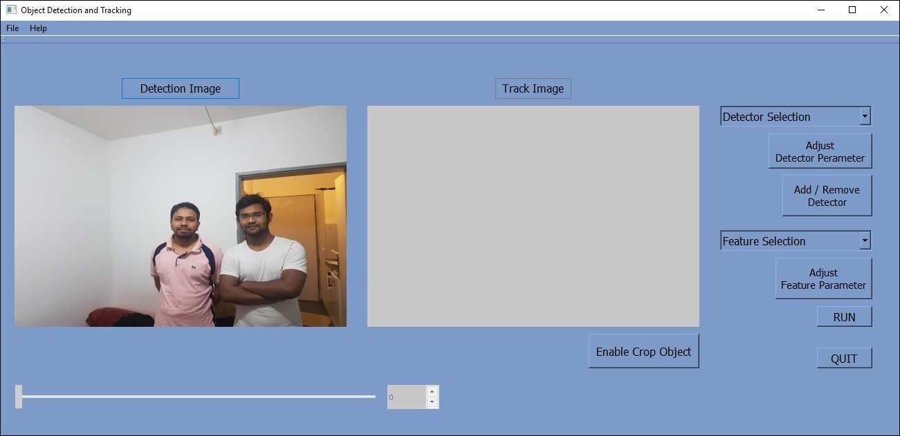
Example 1

Slide 21
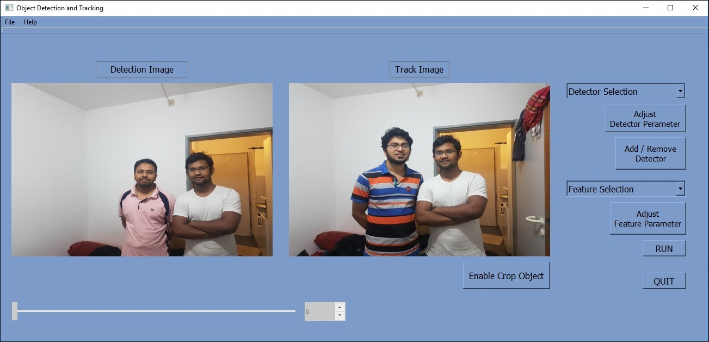
Example 1

Slide 22
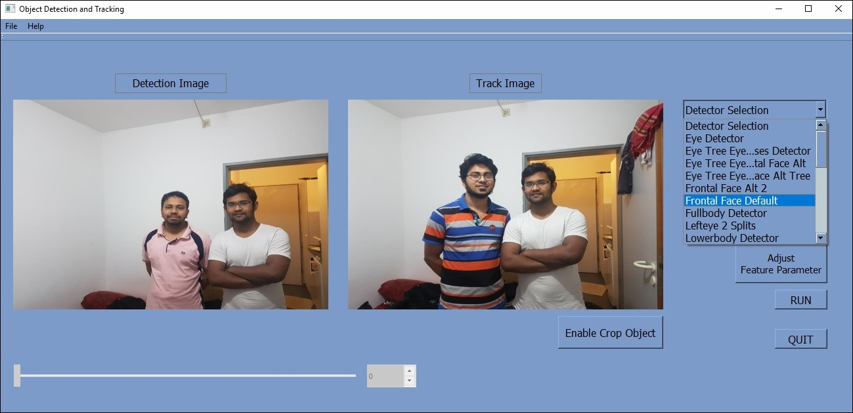
Example 1

Slide 23
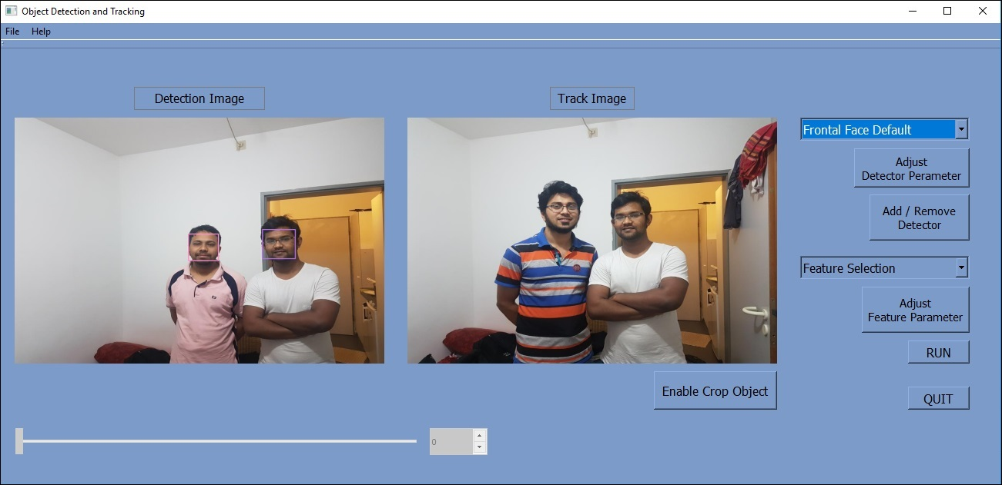
Example 1

Slide 24
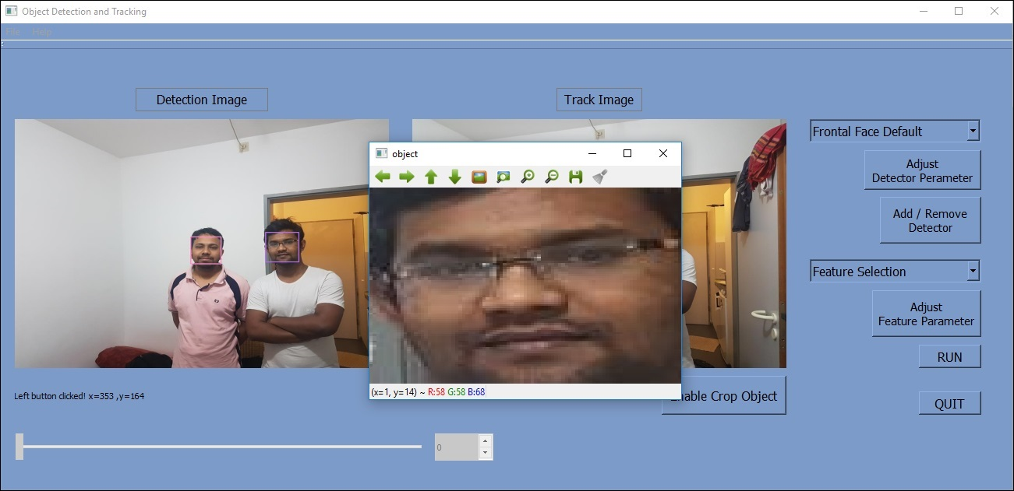
Example 1

Slide 25
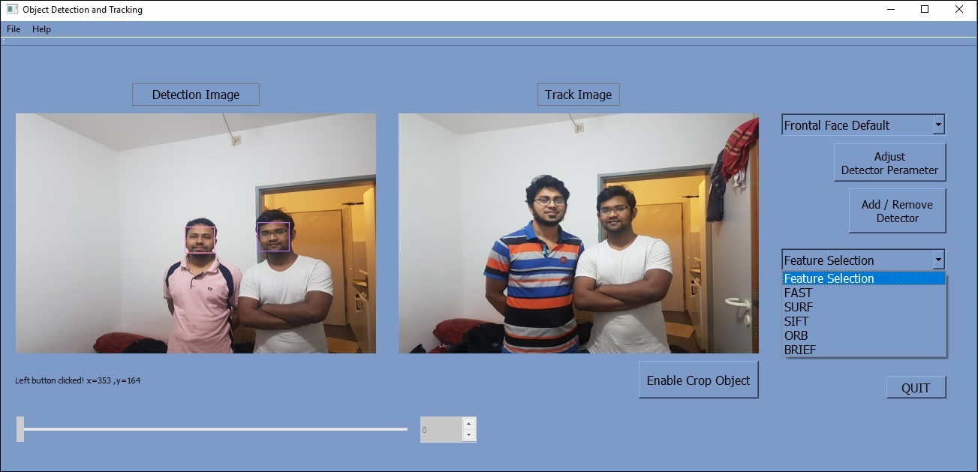
Example 1

Slide 26
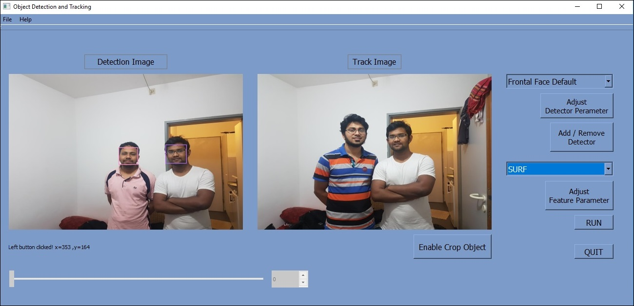
Example 1

Slide 27
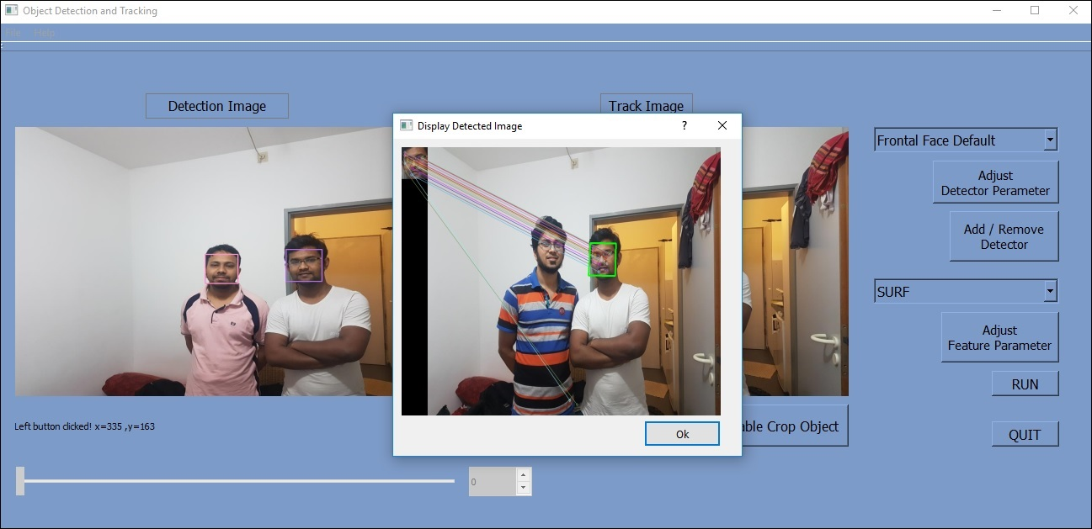
Example 1

Slide 28
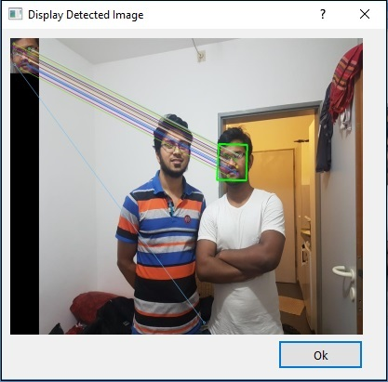
Example 1

Slide 29
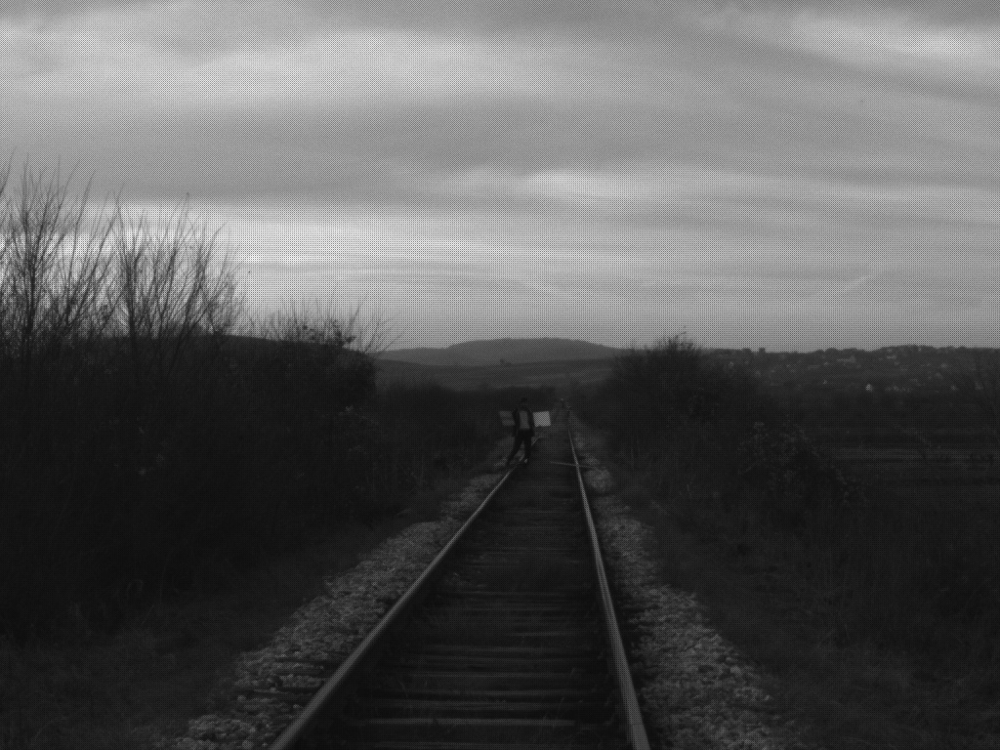
Example 2
Detection Image

Slide 30

Example 2
Tracking Image

Slide 31
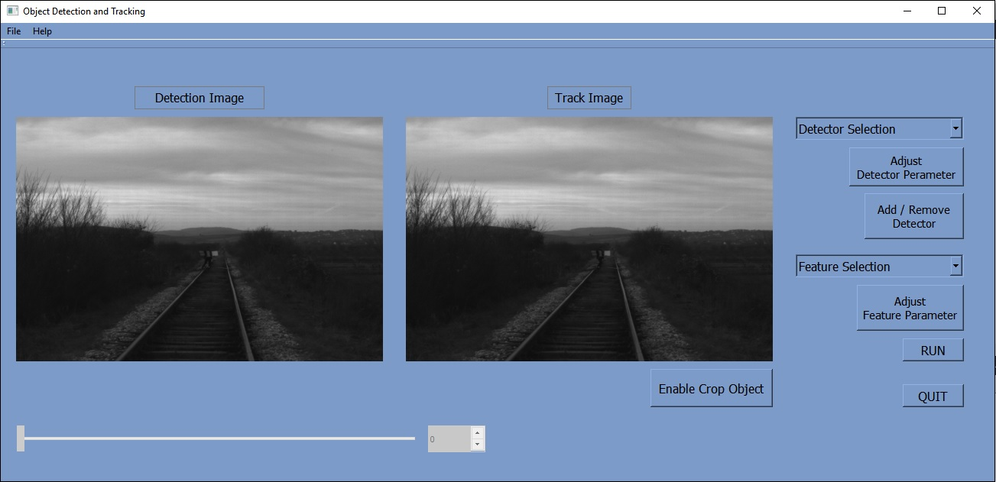
Example 2
In Our Interface

Slide 32
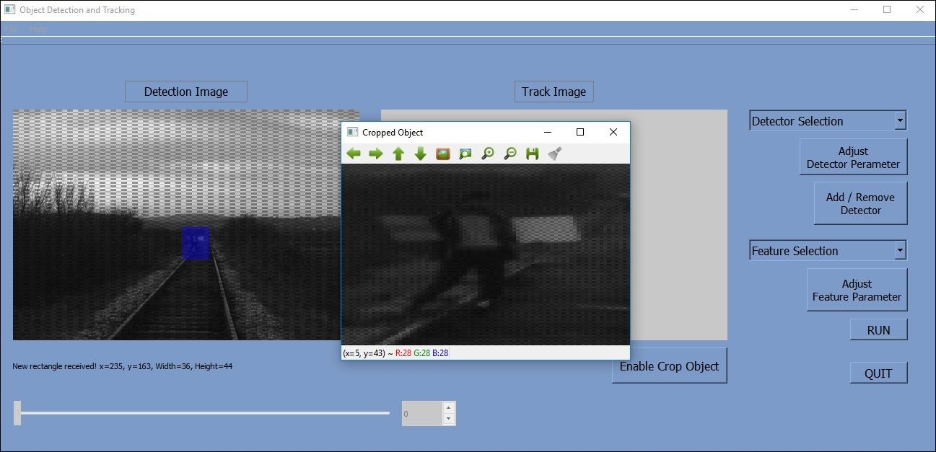
Example 2
In Our Interface

Slide 33
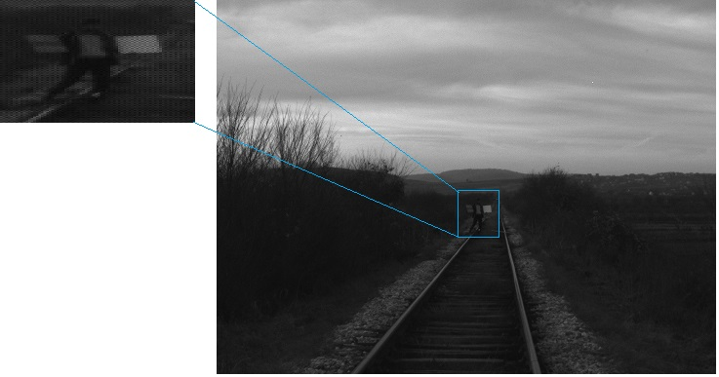
Example 2
In Our Interface

Slide 34
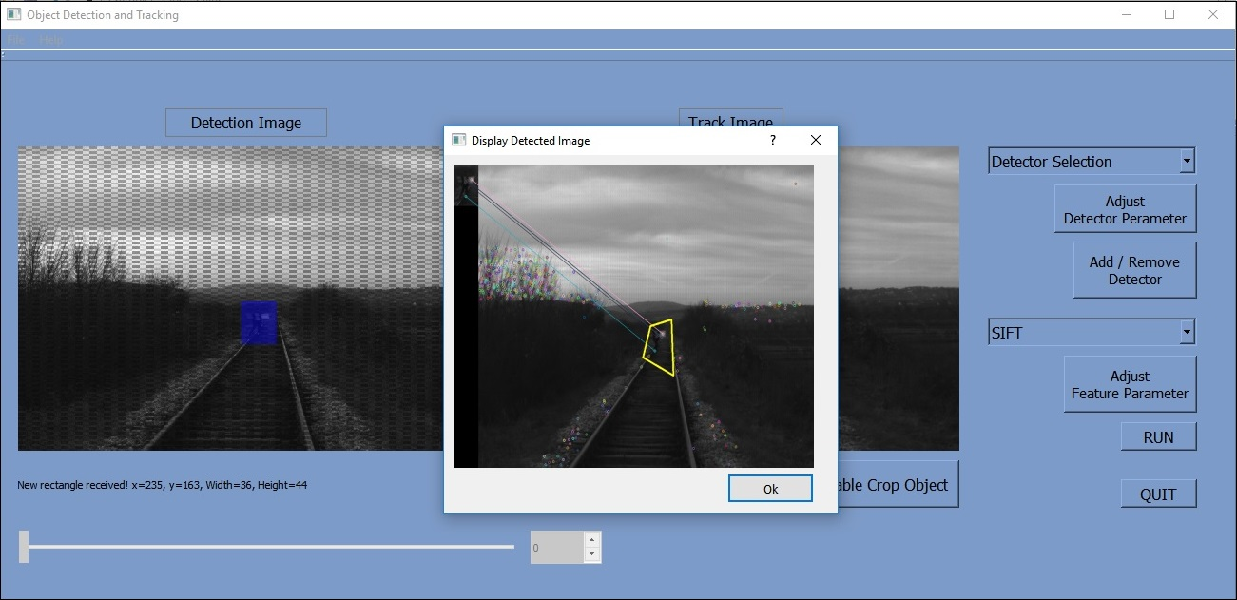
Example 2
In Our Interface

Slide 35
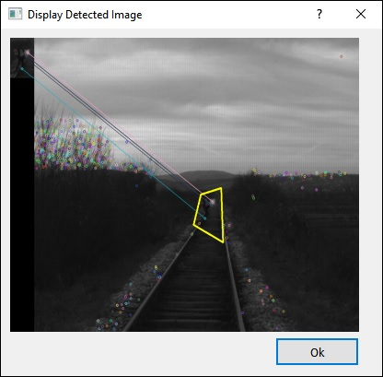
Example 2
In Our Interface

Slide 36
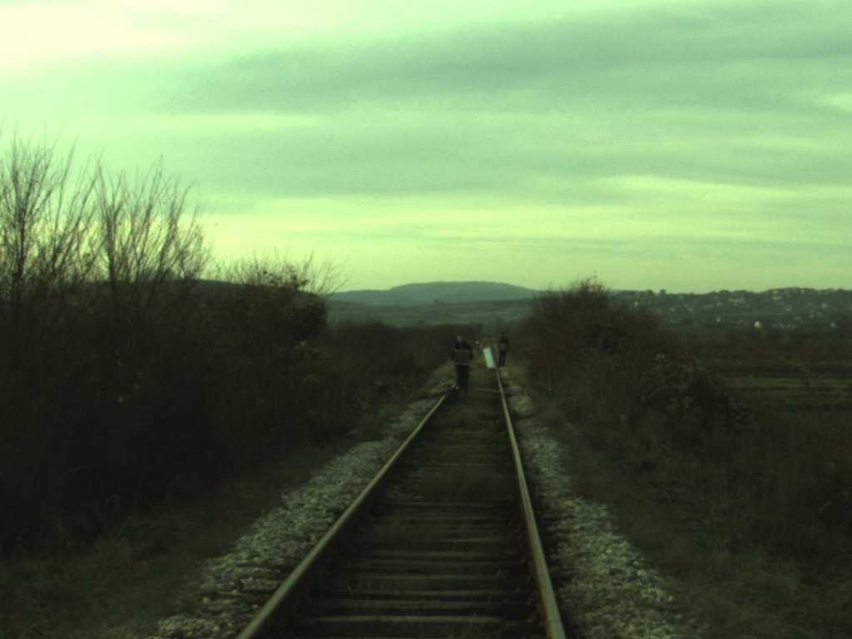
Example 3
Detection Image (Camera_Right)

Slide 37
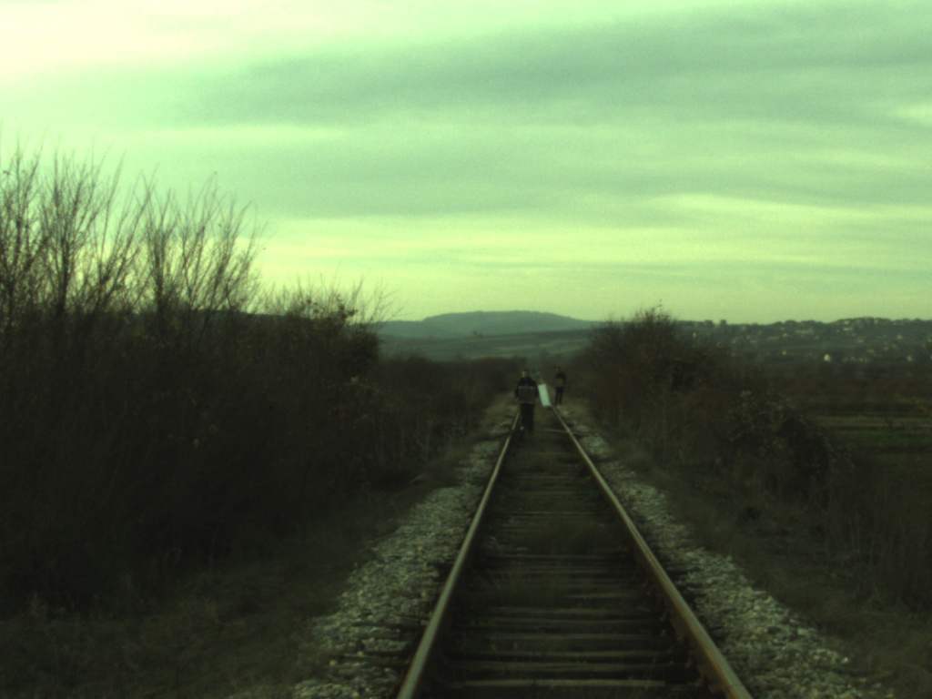
Example 3
Tracking Image (Camera_Left)

Slide 38
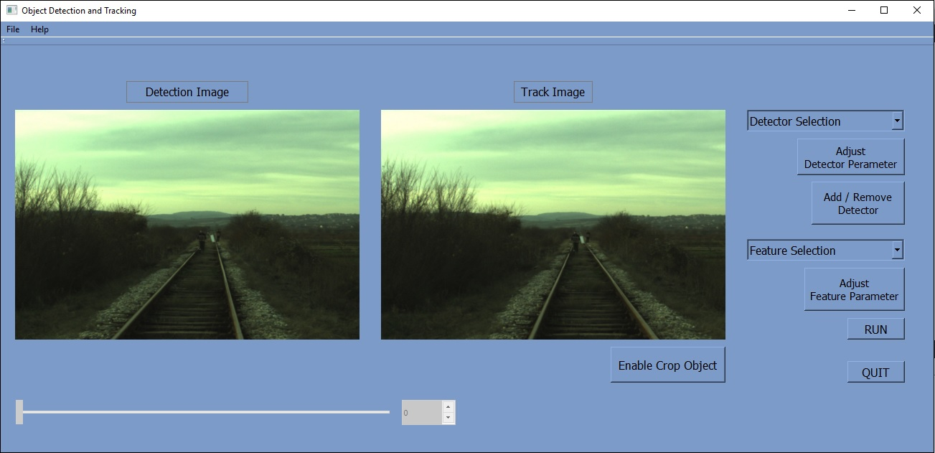
Example 3
In Our Interface

Slide 39
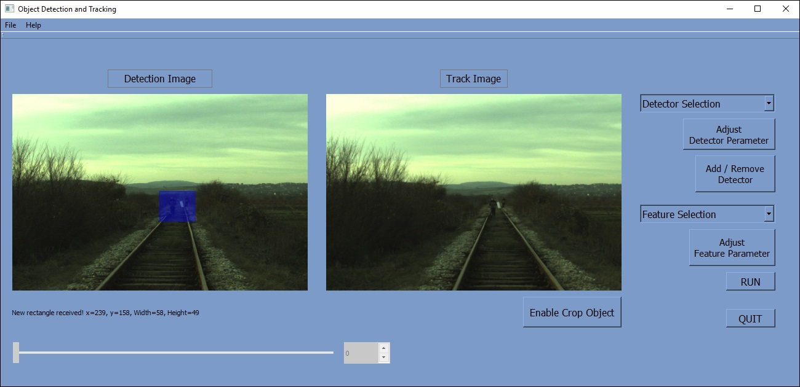
Example 3
In Our Interface

Slide 40
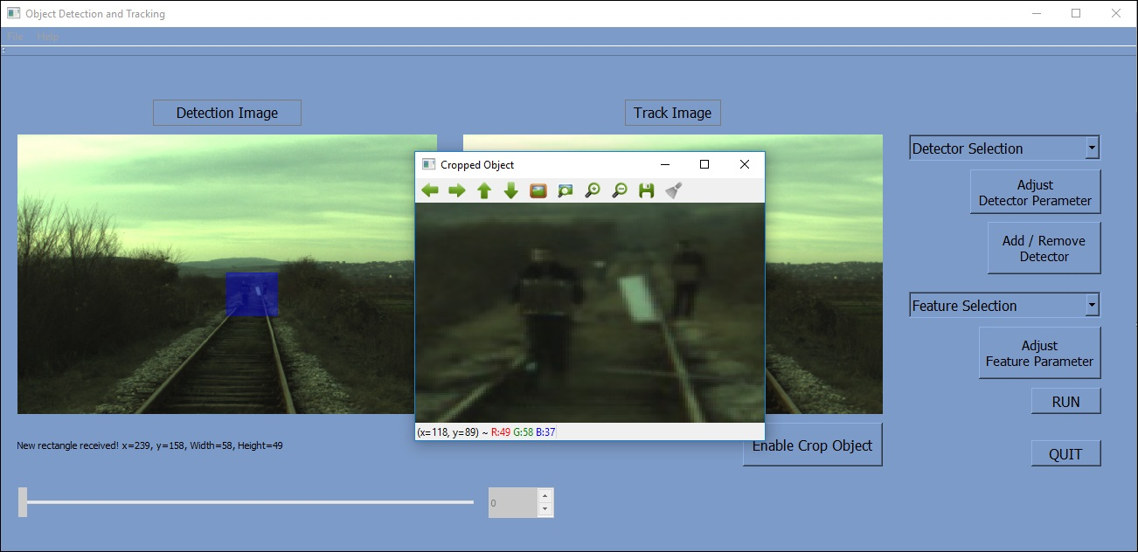
Example 3
In Our Interface

Slide 41
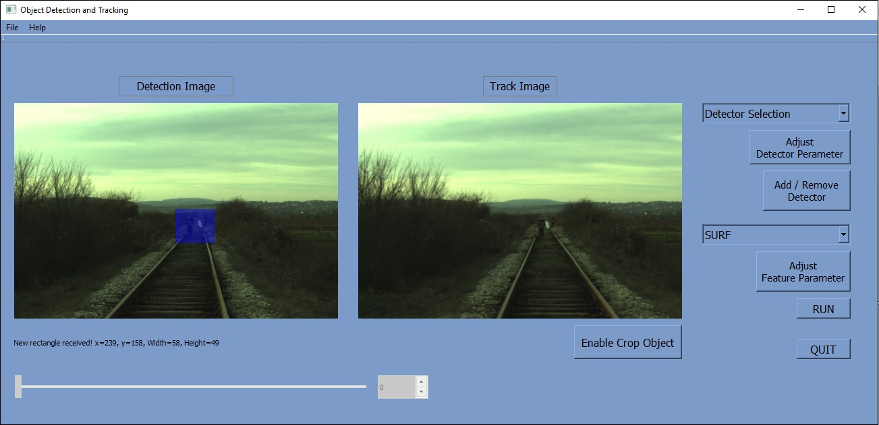
Example 3
In Our Interface

Slide 42
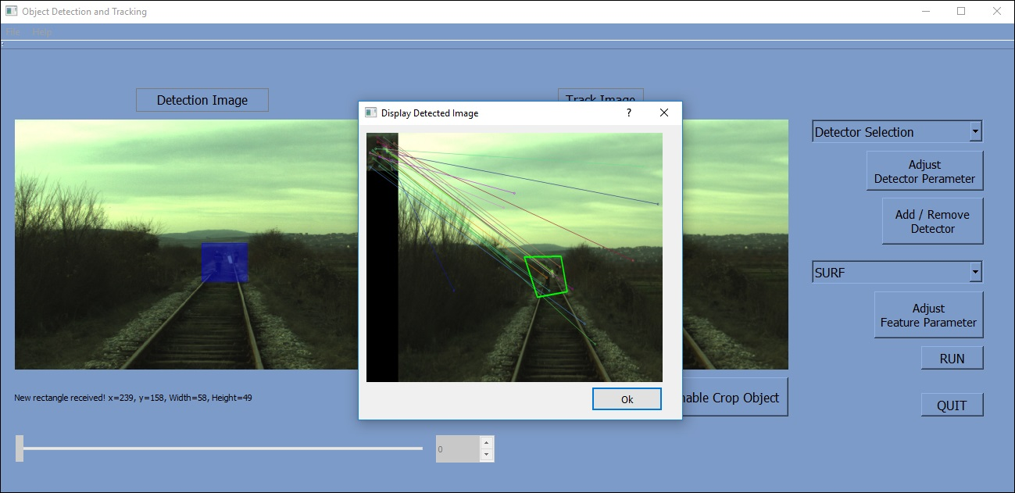
Example 3
In Our Interface

Slide 43
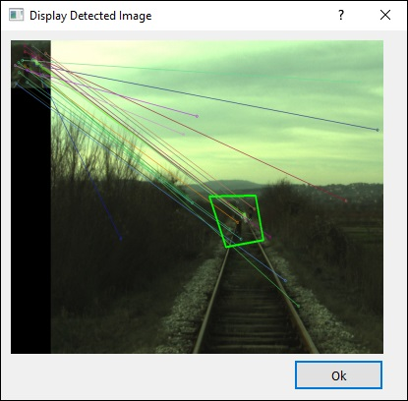
Example 3
In Our Interface

Slide 44
Case Study
Train Cascade Classifier to Detect Rail

Slide 45
Case Study
Trained Cascade Classifier with 3 different features
1) Haar like feature
2) Local Binary Point (LBP) feature
3) Histogram of Oriented Gradient (HOG) feature

Slide 46
Case Study
Training Classifier
1) Positive Image: 360 samples
2) Negative Image: 460 samples

Slide 47
Case Study
When 3 different Rail detector obtained,
we have used 7 different Rail images as our test samples

Slide 48
Case Study
Our Result

Slide 49
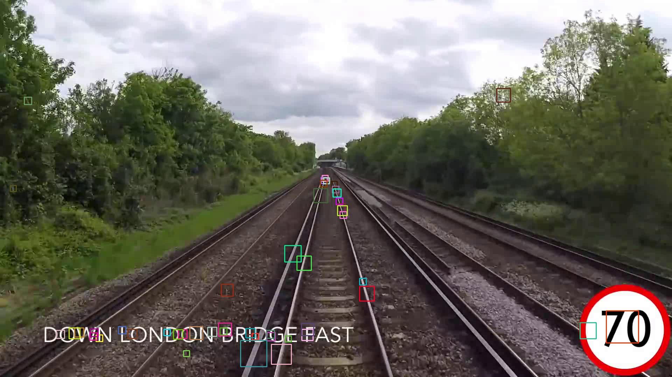
With Haar Like Feature…

Slide 50
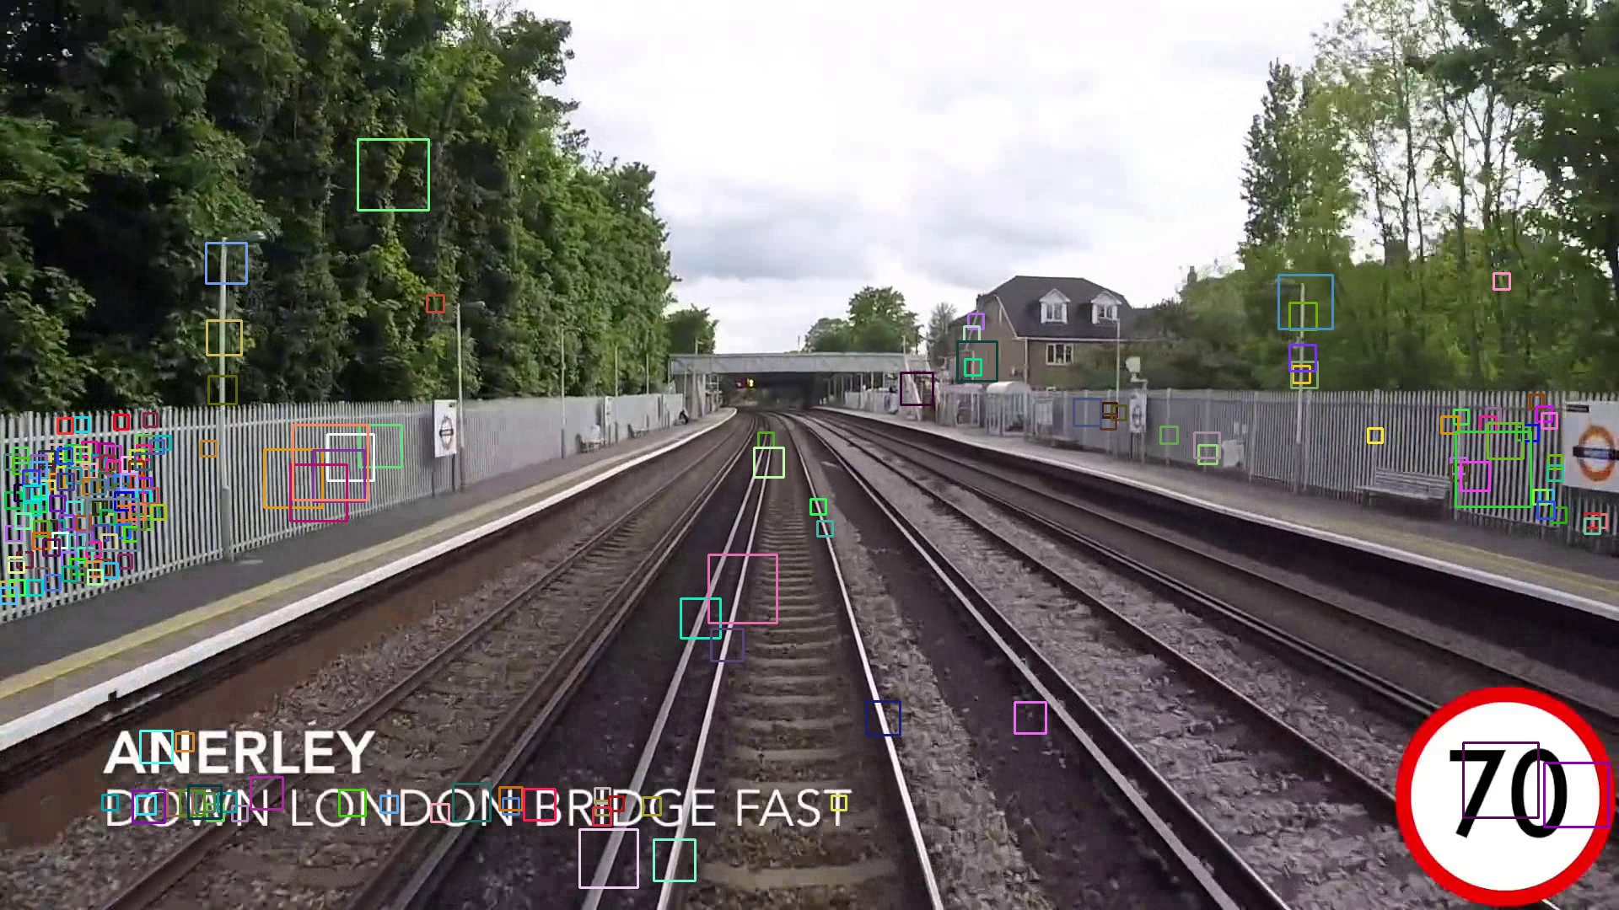
With Haar Like Feature …

Slide 51
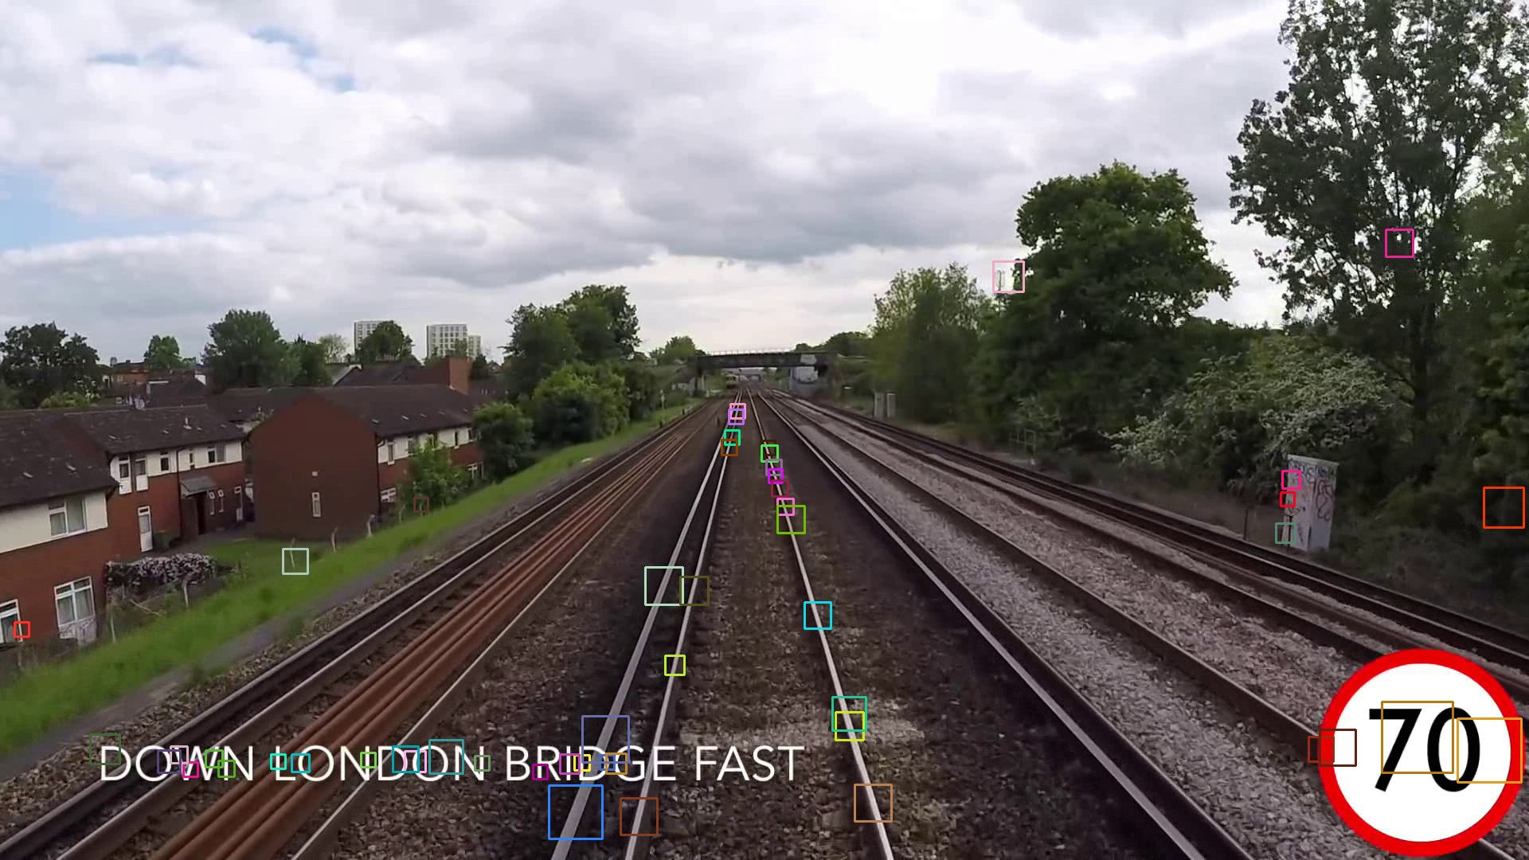
With Haar Like Feature …

Slide 52
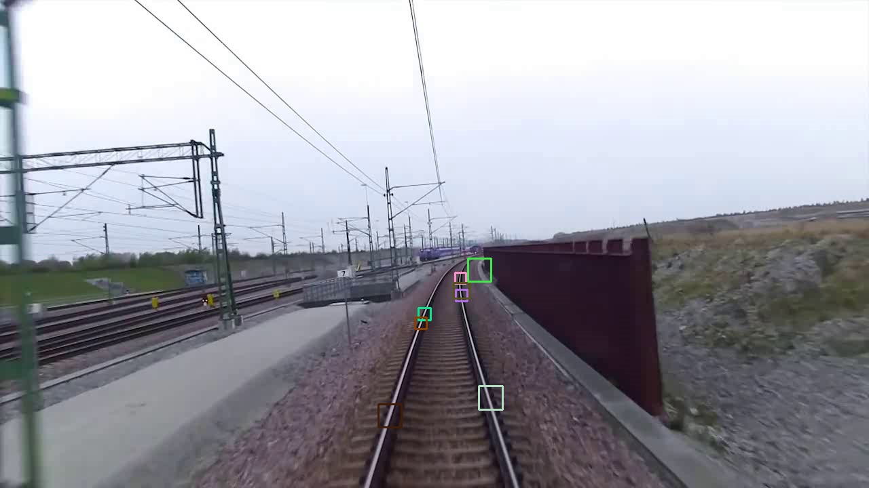
With Haar Like Feature…

Slide 53
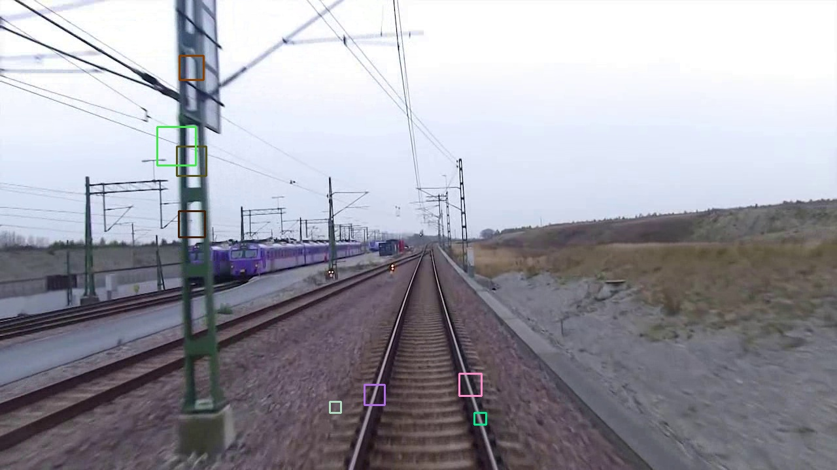
With Haar Like Feature…

Slide 54
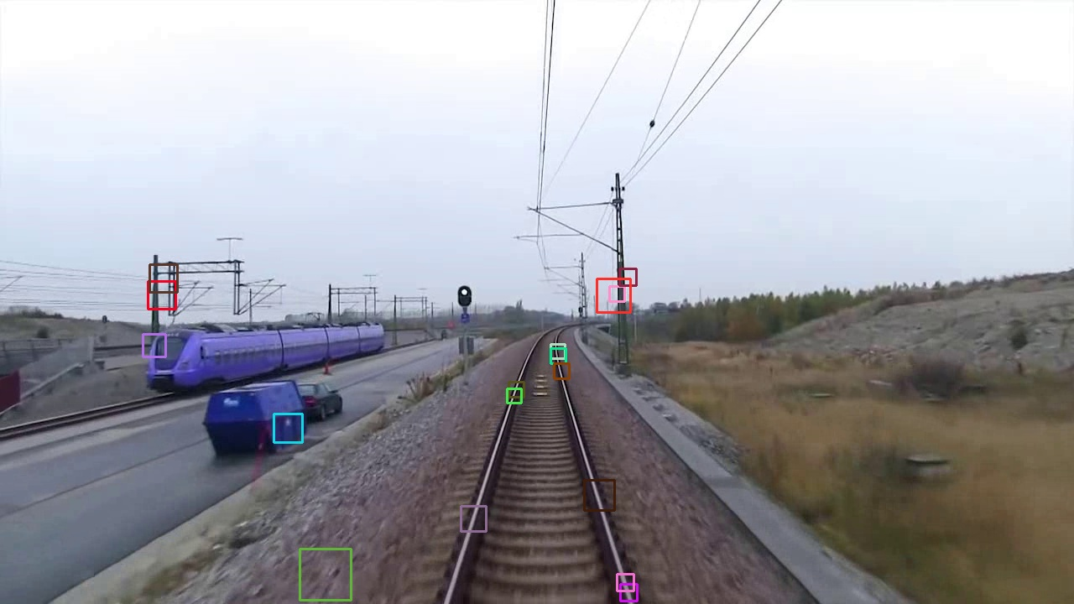
With Haar Like Feature…

Slide 55
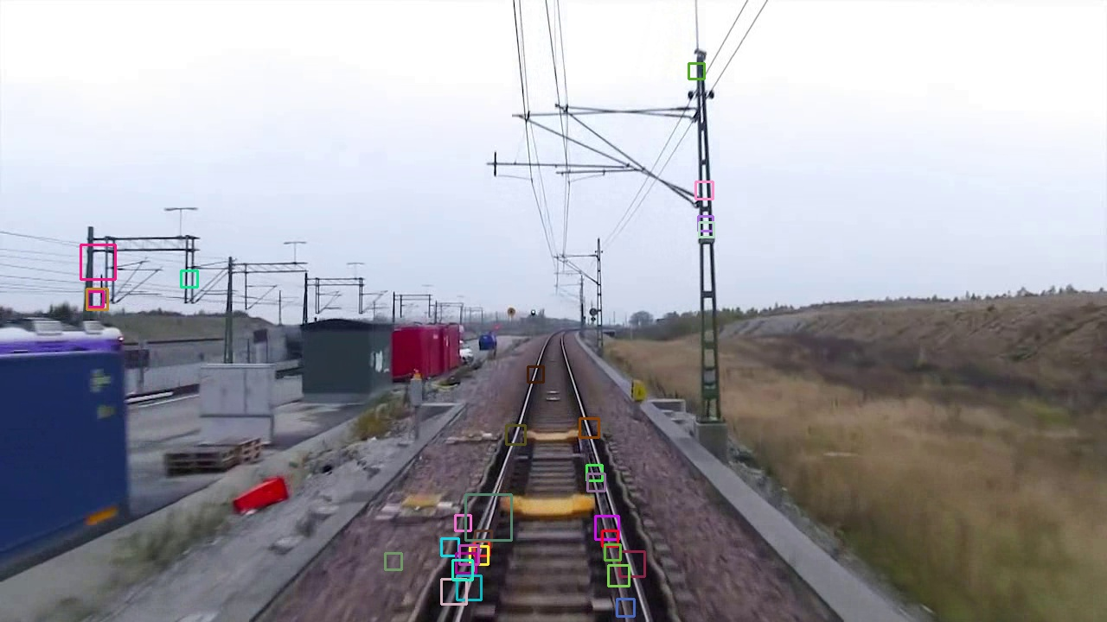
With Haar Like Feature…

Slide 56

With LBP Feature…

Slide 57
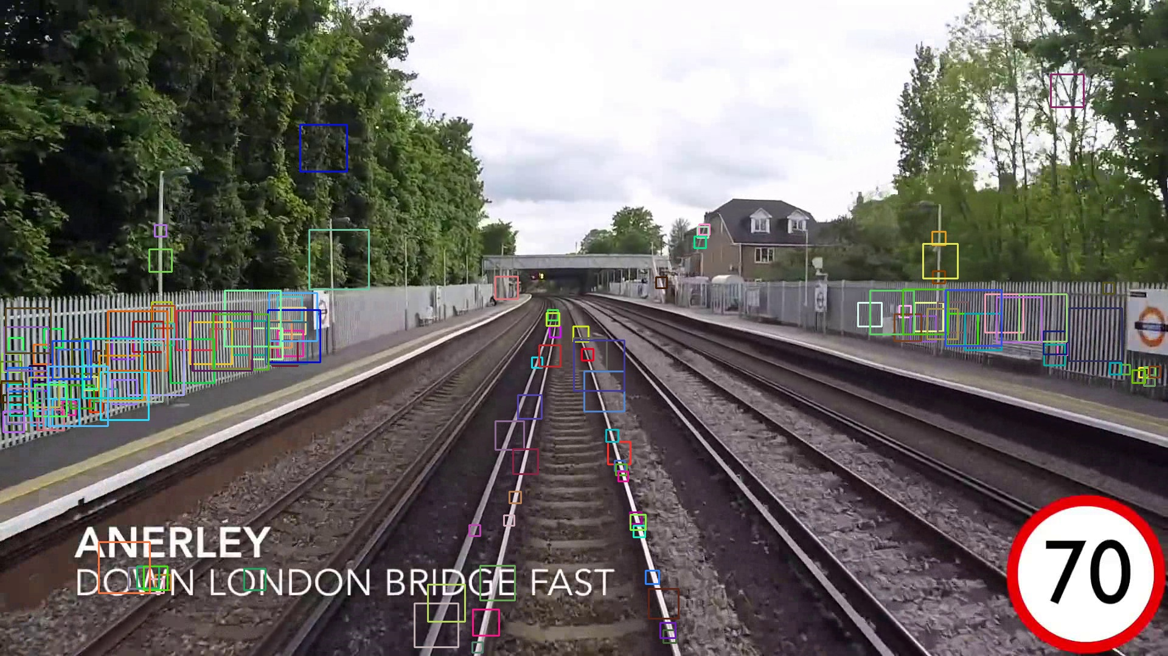
With LBP Feature…

Slide 58
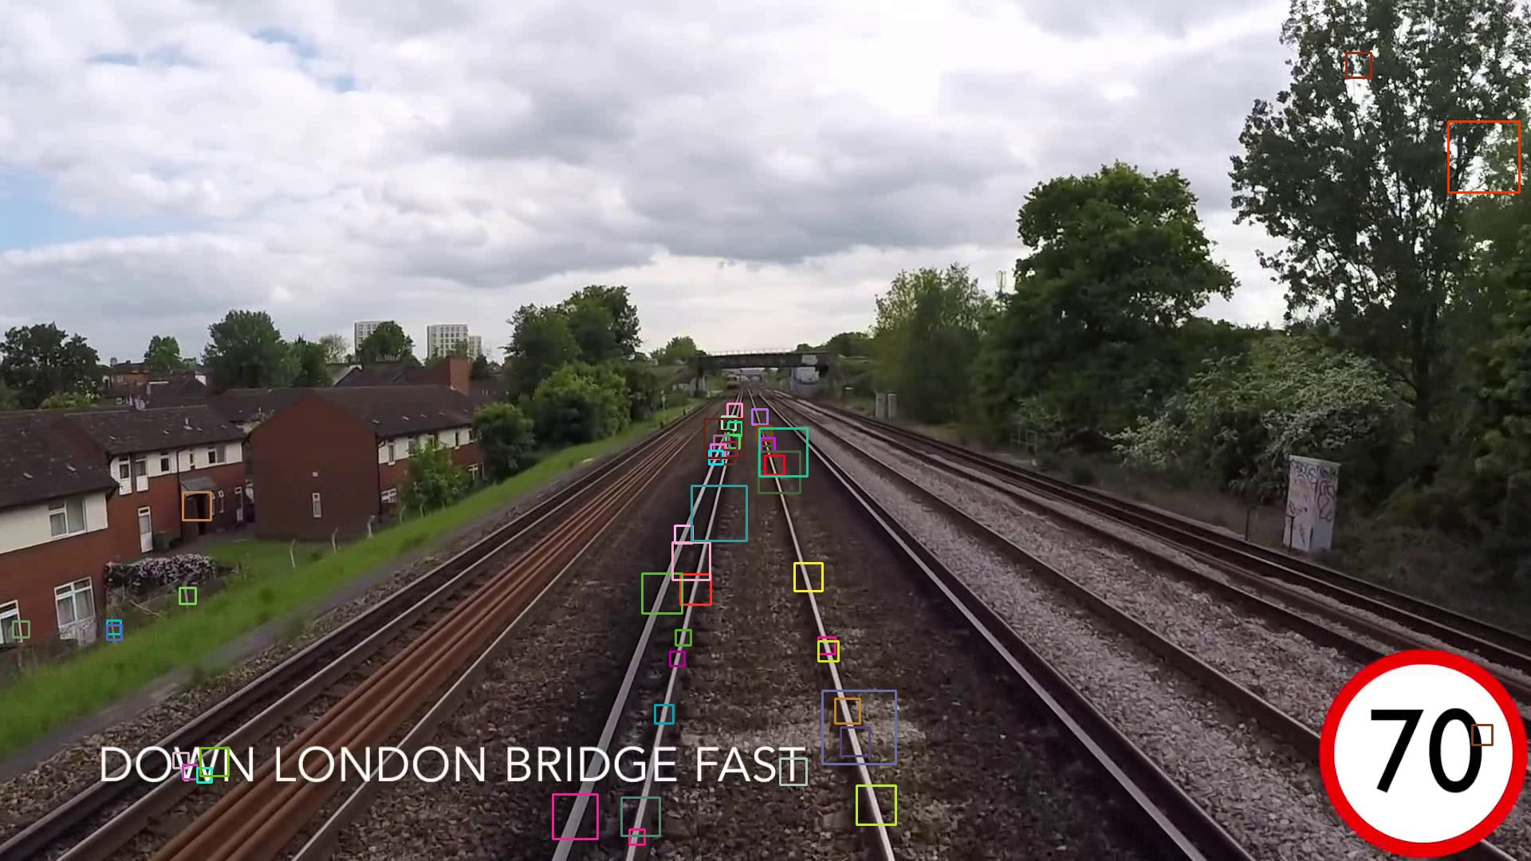
With LBP Feature…

Slide 59
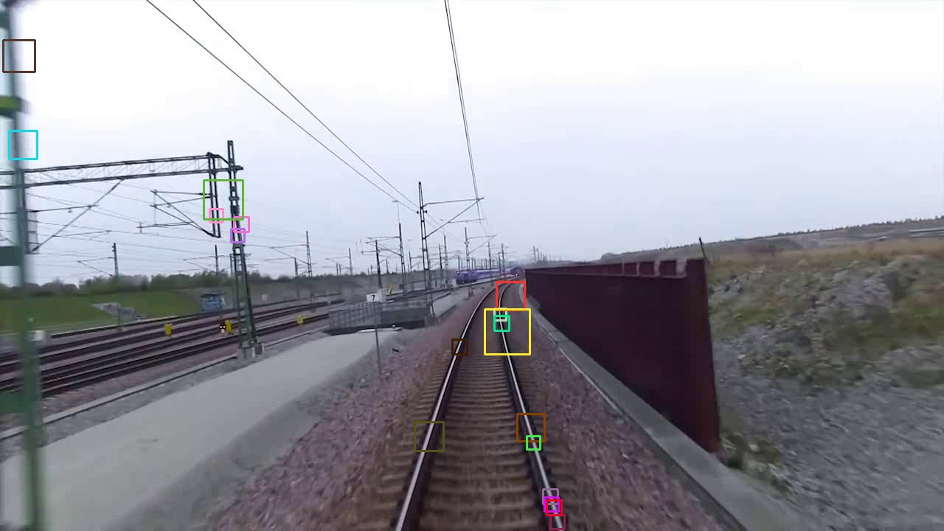
With LBP Feature…

Slide 60

With LBP Feature…

Slide 61
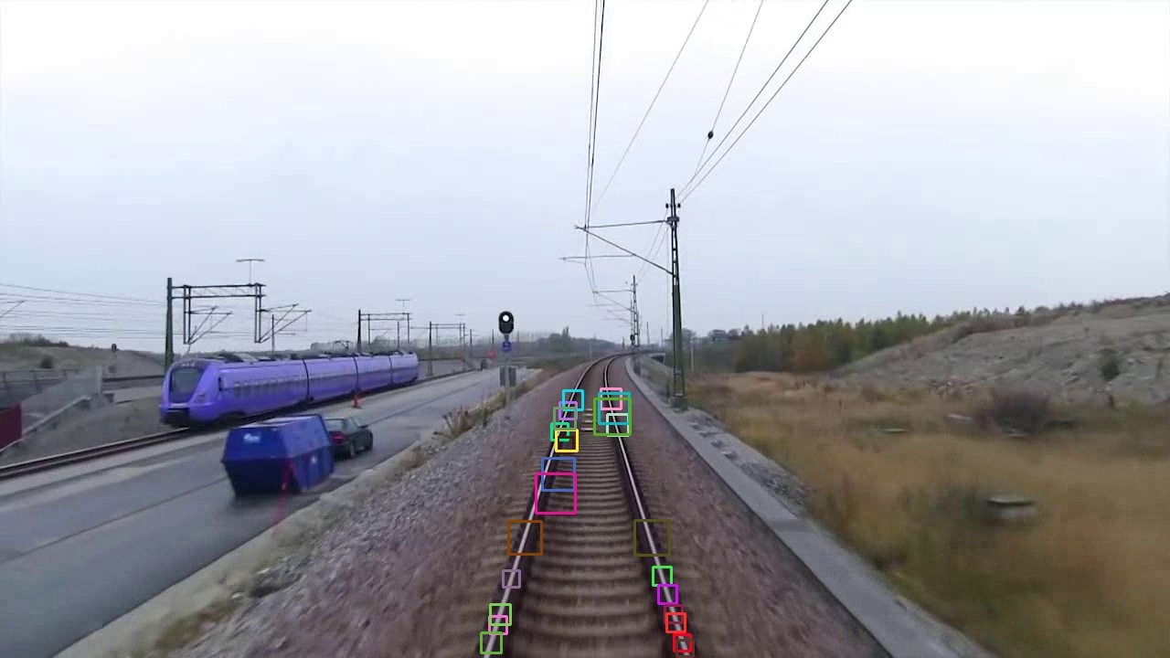
With LBP Feature…

Slide 62
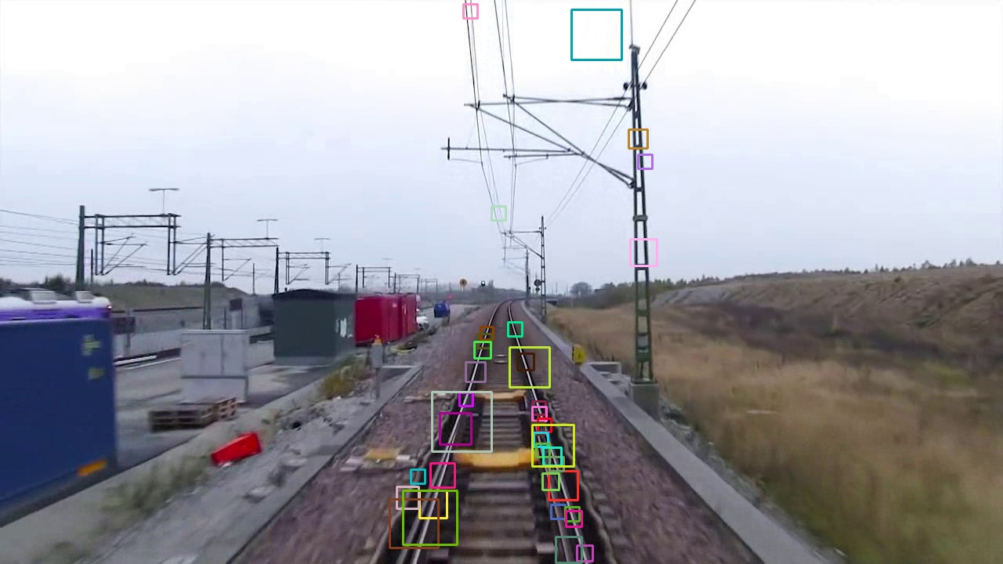
With LBP Feature…

Slide 63
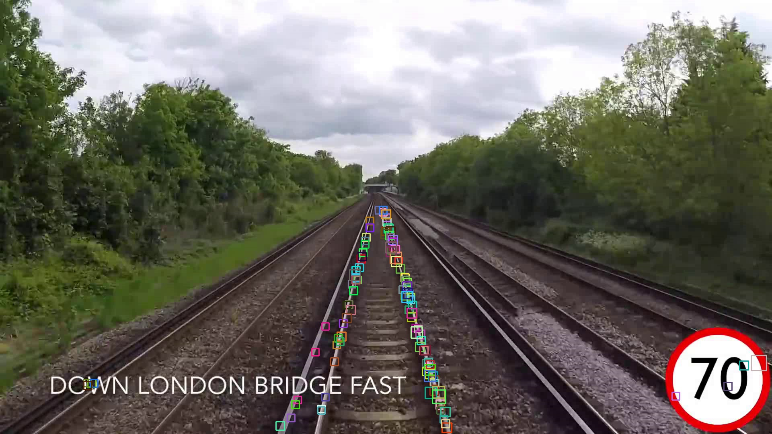
With HOG Feature…

Slide 64
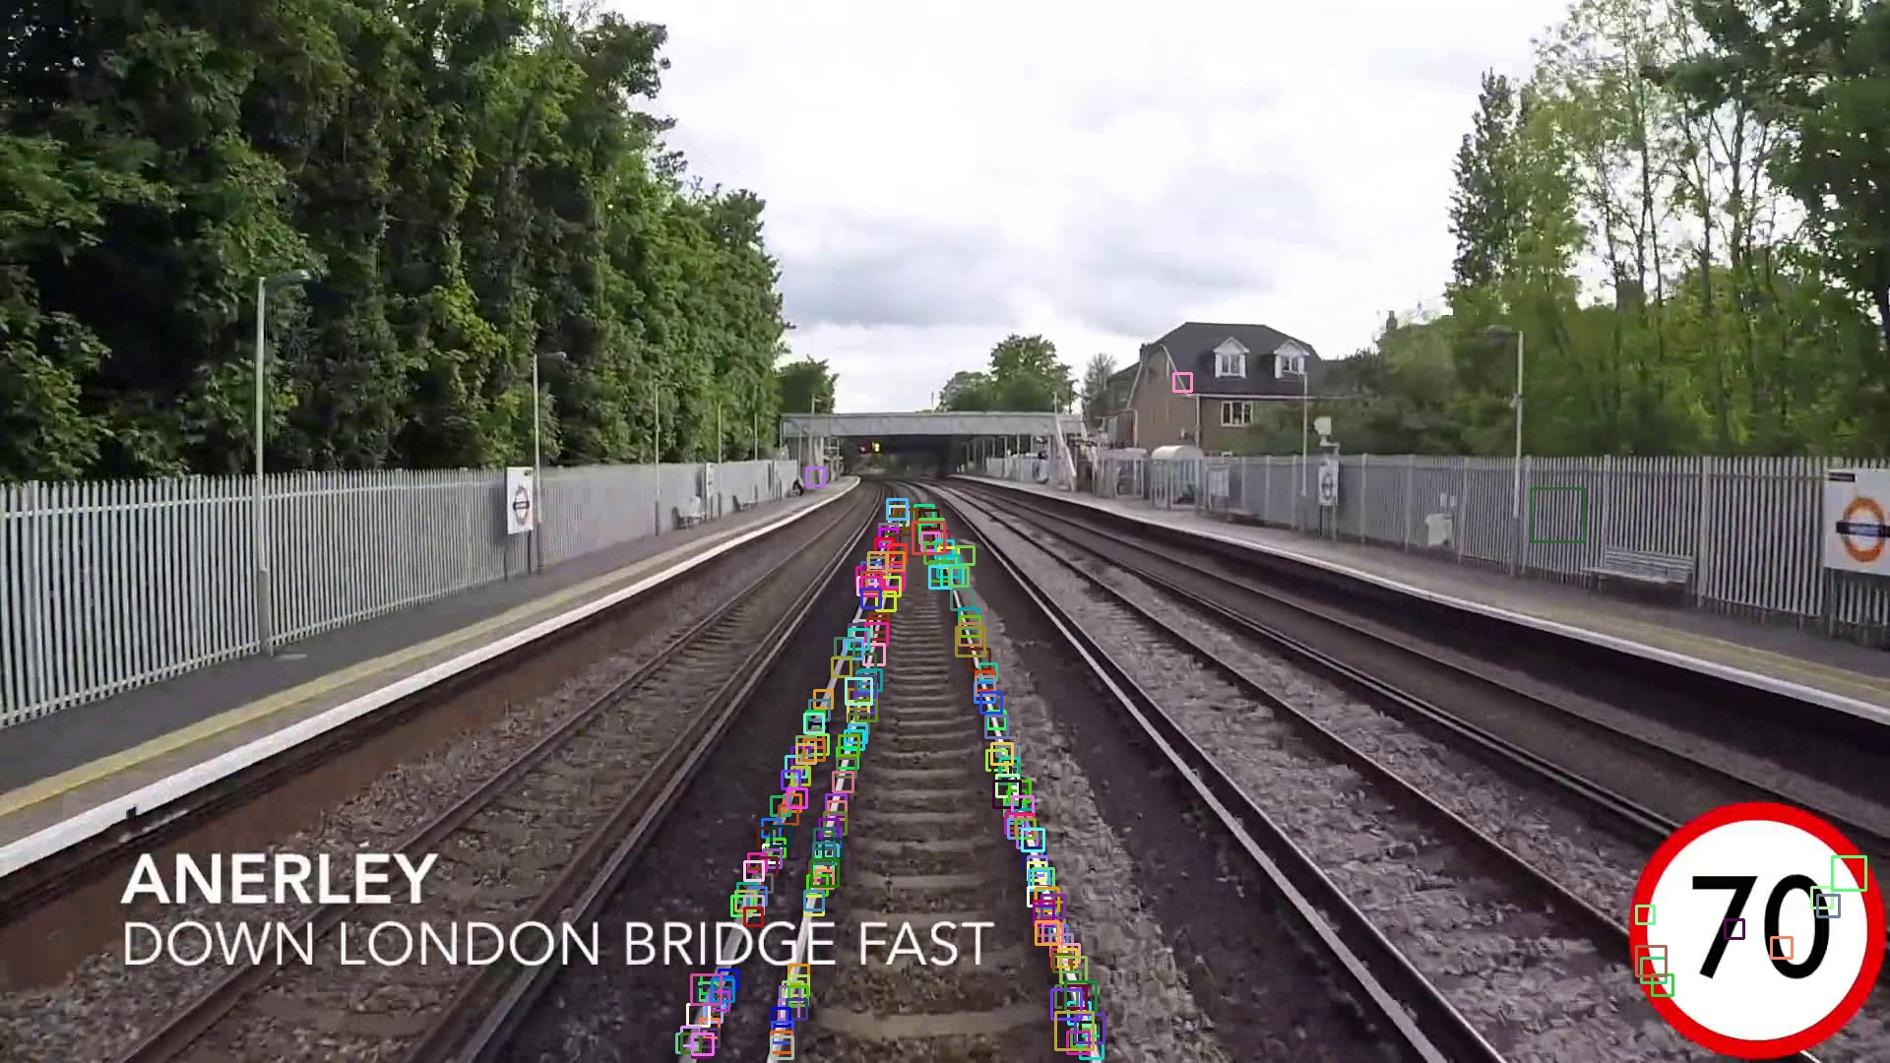
With HOG Feature…

Slide 65
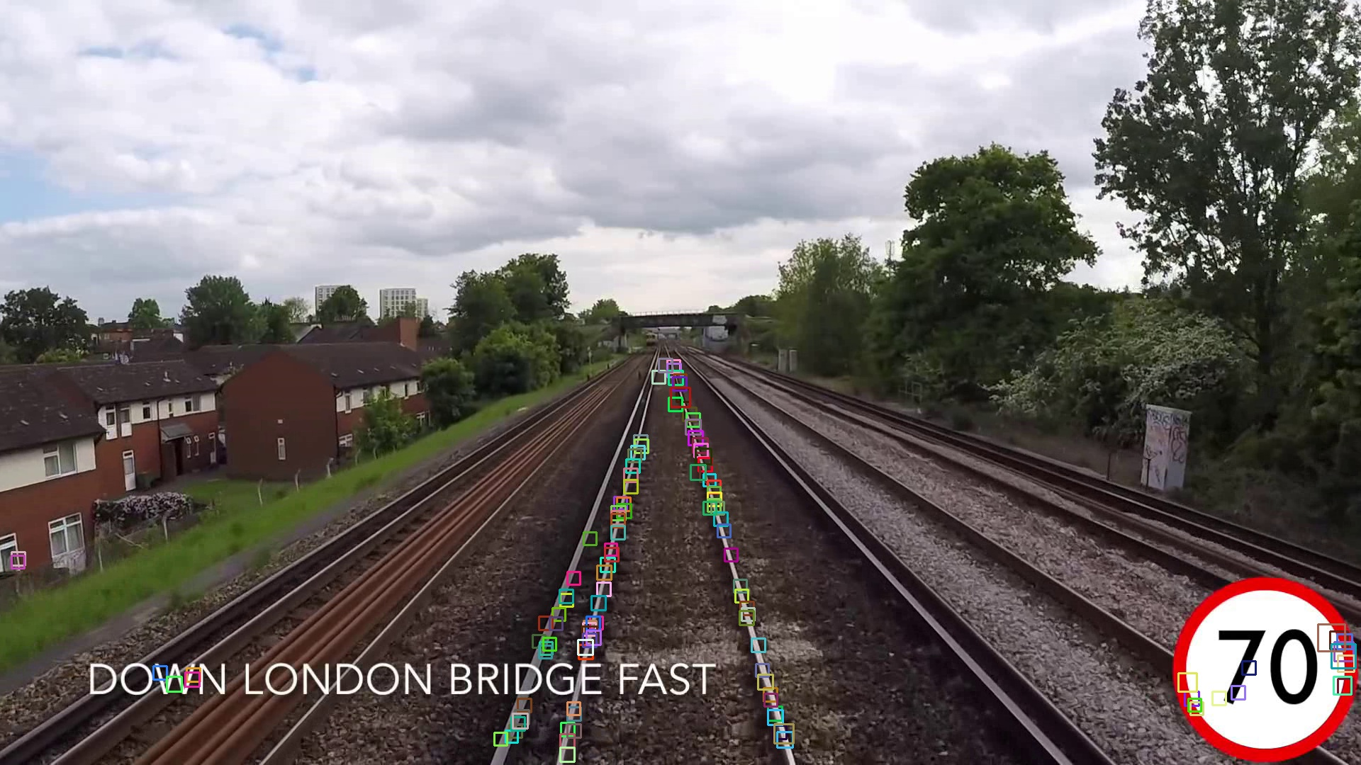
With HOG Feature…

Slide 66

With HOG Feature…

Slide 67
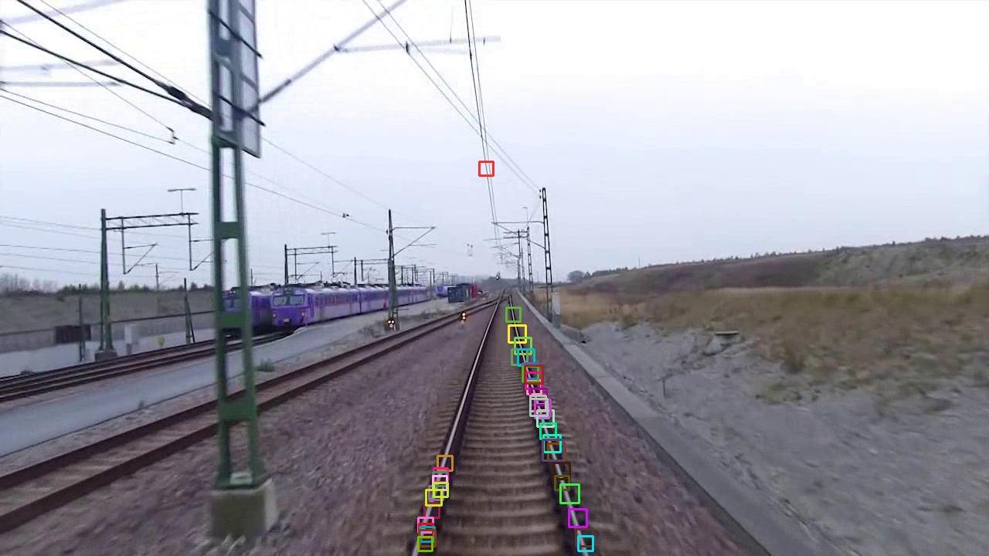
With HOG Feature…

Slide 68
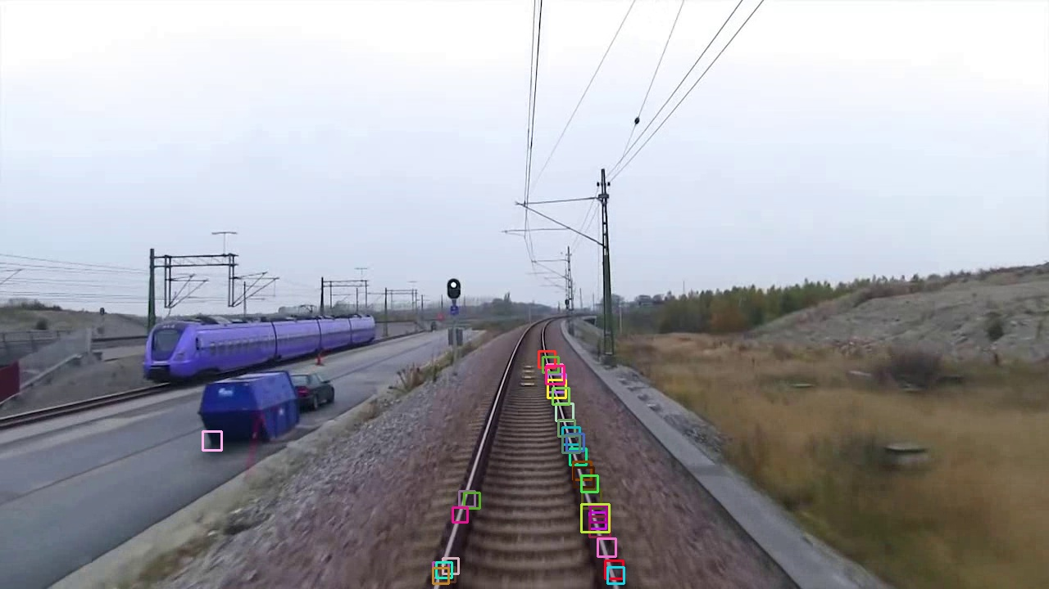
With HOG Feature…

Slide 69
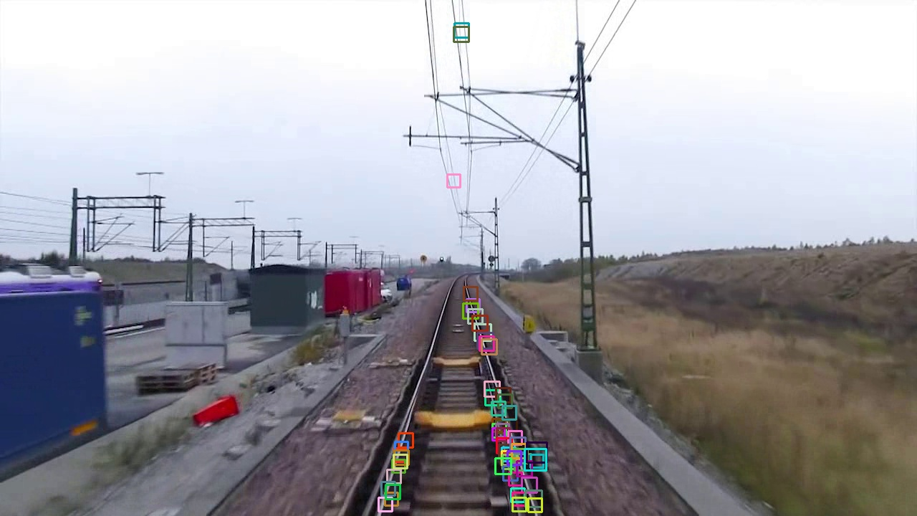
With HOG Feature…

Slide 70
Performance Evaluation
Performance Evaluation of these detectors have been measured in terms of Precision Rate (PR).
True Positive(TP) are the number of correctly identified rail lines as rail by detector.
False Positive(FP) are the number of objects which are not rail line, but incorrectly identified as rail.
Precision Rate is the ratio of True Positive (TP) to the sum of True Positive (TP) and False Positive (FP).

Slide 71
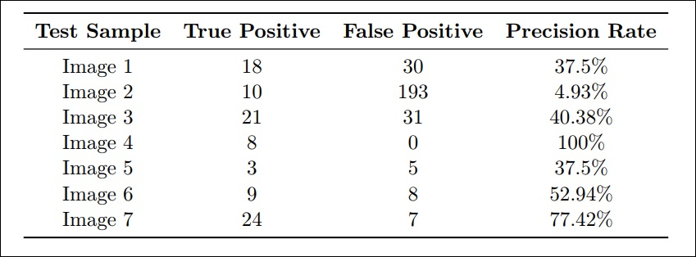
Performance Evaluation
Haar Like Detector

Slide 72
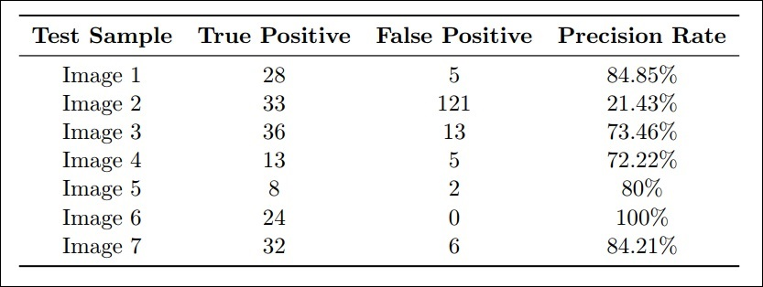
Performance Evaluation
LBP Detector

Slide 73

Performance Evaluation
HOG Detector

Slide 74

Performance Evaluation
Average Precision Rate (APR)

Slide 75
Thank you
Questions???

